Slide 1




Rajeshwari Vedachalam Government Arts & Science college , Chengalpattu PG Department of Computer Science
OPTIMIZING FLIGHT BOOKINg DECISIONS THROUGH MACHINE LEARNINGPRICE PREDICTIONS
TEAM MEMBERS
1. Elavarasan k
2. Jayavishva D
3. Naveen V
4. Giritharan V

Slide 2


Define Problem / Problem Understanding
Specify the business problem
People who work frequently travel through flight will have better knowledge on best discount and right time to buy the ticket. For the business purpose many airline companies change prices according to the seasons or time duration. They will increase the price when people travel more. Estimating the highest prices of the airlines data for the route is collected with features such as Duration, Source, Destination, Arrival and Departure.
Logistic regression, decision tree, random forest, and neural networks have all been used and have been able to accurately predict loan defaults.
Social or Business Impact.

Slide 3
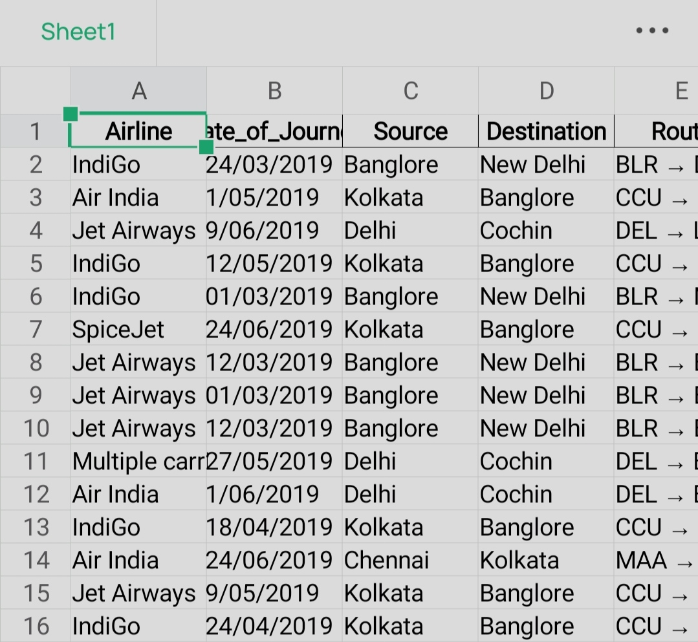
Data Collection & Preparation
Collect the dataset from open sources.
Ex: Kaggle.com
Importing the necessary libraries
Read the Dataset
Data Preparation : Handling missing values, Handling categorical data, Handling outliers, Scaling Techniques, Splitting dataset into training and test set.
Replacing Missing Values.
Label Encoding , Output columns

Slide 4
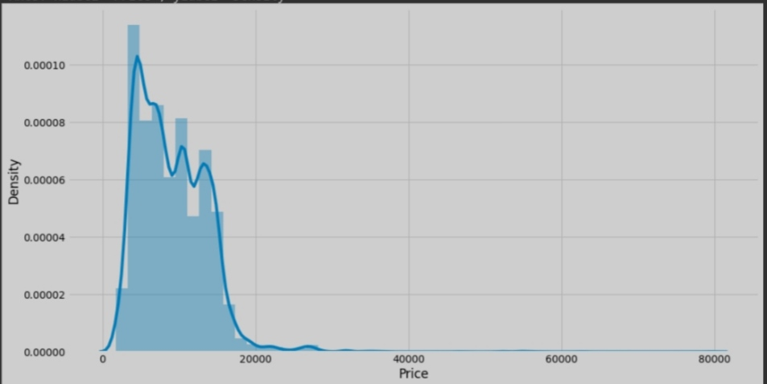
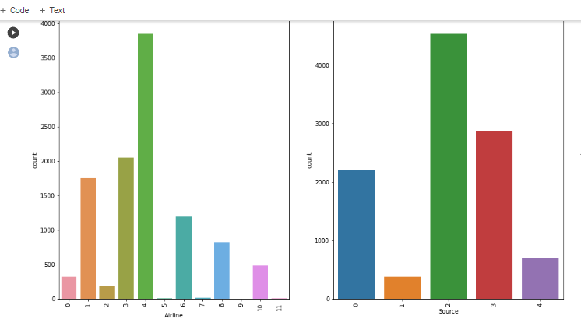
Exploratory Data Analysis
Descriptive analysis is to study the basic features of data with the statistical process.
Visual analysis is the process of using visual representations.
Univariate analysis, Bivariate analysis to Multivariate analysis to represent in graph.
Scaling the data Splitting data into train and test

Slide 5
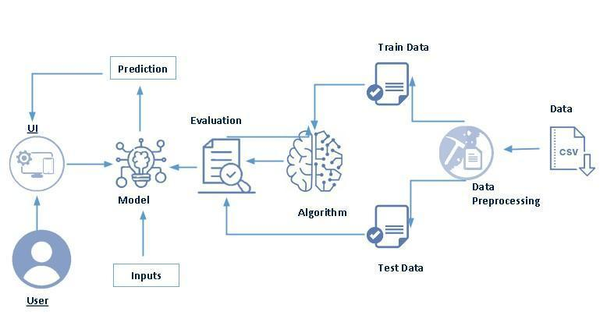
Technical Architecture:

Slide 6

Model Building
Training the model in multiple evaluation metrics
A function named Random Forest, Gradient Boosting, AdaBoost is created and train and test data are passed as the parameters.
Regression Model : A function named KNN, SVR, DecisionTree is created and train and test data are passed as the parameters.
Checking cross validation for RandomforestRegressor
Tesing the mode
Accuracy percentage ( after tuning ) : 0.7898840463814475

Slide 7

Performance Testing & Hyperparameter Tuning
Testing model with multiple evaluation metrics
Compare the model
Comparing model accuracy before & after applying hyperparameter tuning
Accuracy percentage ( after tuning ) : 0.844567328769076

Slide 8

Model Deployment
Saving the best model after comparing its performance
Integrate with web framework : Building a web application that is integrated to the model
Building HTML pages and python codes and import libraries then finally run the web application into our system

Slide 9

THANK YOU

